Slide 1
Metadata-driven Threat Classification of Network Endpoints Appearing in Malware
Andrew G. West and Aziz Mohaisen (Verisign Labs)
July 11, 2014 – DIMVA – Egham, United Kingdom

Slide 2
PRELIMINARY OBSERVATIONS
Program code
Drop sites
x 1000
C&C instruction
1. HTTP traffic is ubiquitous in malware
2. Network identifiers are relatively persistent
3. Migration has economic consequences
4. Not all contacted endpoints are malicious

Slide 3
OUR APPROACH AND USE-CASES
Our approach
Obtained 28,000 *expert-labeled* endpoints, including both threats (of varying severity) and non-threats
Learn *static* endpoint properties that indicate class:
• Lexical: URL structure • WHOIS: Registrars and duration
• n-gram: Token patterns • Reputation: Historical learning
USE-CASES: Analyst prioritization; automatic classification
TOWARDS: Efficient and centrally administrated blacklisting
End-game takeaways
Prominent role of DDOS and “shared” use services
99.4% accuracy at binary task; 93% at severity prediction
Notes:
* Reduce man hours

Slide 4
Classifying Endpoints with Network Metadata
1. Obtaining and labeling malware samples
2. Basic/qualified corpus properties
3. Feature derivation [lexical, WHOIS, n-gram, reputation]
4. Model-building and performance

Slide 5
SANDBOXING & LABELING WORKFLOW
AUTONOMOUS
processes
registry
filesystem
Malware samples
AutoMal (sandbox)
network
PCAP file
Potential
Threat-indicators
HTTP endpoint parser
ANALYST-DRIVEN
Is there a benign use-case?
http://sub.domain.com/.../file1.html
How severe is the threat?
http://sub.domain.com/
Non-threat
High-threat
domain.com
Med-threat
Low-threat
Can we generalize this claim?

Slide 6
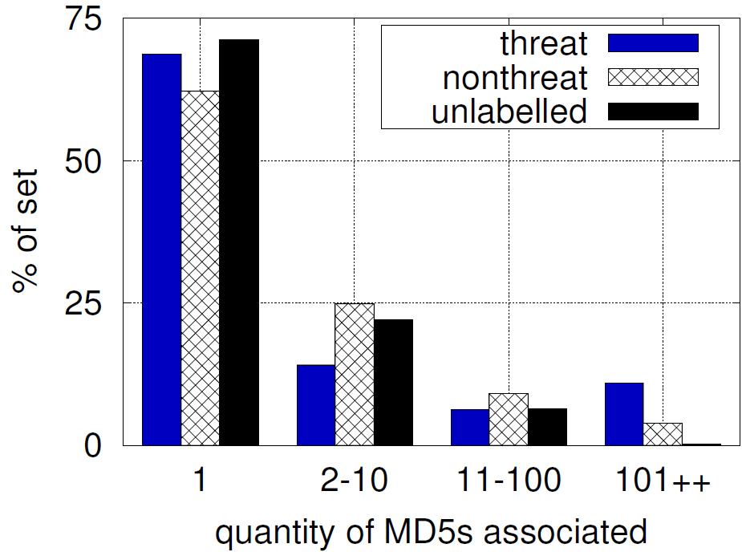
EXPERT-DRIVEN LABELING
Where do malware samples come from?
Organically, customers, industry partners
93k samples → 203k endpoints → 28k labeled
LEVEL | EXAMPLES
LOW-THREAT | “Nuisance” malware; ad-ware
MED-THREAT | Untargeted data theft; spyware; banking trojans
HIGH-THREAT | Targeted data theft; corporate and state espionage
Verisign analysts select potential endpoints
Expert labeling is not very common [1]
Qualitative insight via reverse engineering
Selection biases
os.solvefile.com 1901 binaries
Fig: Num. of malware MD5s per corpus endpoint

Slide 7
Classifying Endpoints with Network Metadata
1. Obtaining and labeling malware samples
2. Basic/qualified corpus properties
3. Feature derivation [lexical, WHOIS, n-gram, reputation]
4. Model-building and performance

Slide 8
BASIC CORPUS STATISTICS
73% of endpoints are threats (63% estimated in full set)
4 of 5 endpoint labels can be generalized to domain granularity
Some 4067 unique second level domains (SLDs) in data; statistical weighting
TOTAL |  |  | 28,077
DOMAINS |  | 21,077 | 75.1%
high-threat med-threat low-threat non-threat | 5,744 107 11,139 4,087 | 27.3% 0.5% 52.8% 19.4%
URLS |  | 7,000 | 24.9%
high-threat med-threat low-threat non-threat | 318 1,299 2,005 3,378 | 4.5% 18.6% 28.6% 48.3%
Tab: Corpus composition by type and severity

Slide 9
QUALITATIVE ENDPOINT PROPERTIES
System doesn’t care about content; for audience benefit…
What lives at malicious endpoints?
Binaries: Complete program code; pay-per-install
Botnet C&C: Instruction sets of varying creativity
Drop sites: HTTP POST to return stolen data
What lives at “benign” endpoints?
Reliable websites (connectivity tests or obfuscation)
Services reporting on infected hosts (IP, geo-location, etc.)
Advertisement services (click-fraud malware)
Images (hot-linked for phishing/scare-ware purposes)

Slide 10
COMMON SECOND-LEVEL DOMAINS
Non-dedicated and shared-use settings are problematic
THREATS |  |  | NON-THREATS
SLD | # |  | SLD | #
3322.ORG | 2,172 |  | YTIMG.COM | 1,532
NO-IP.BIZ | 1,688 |  | PSMPT.COM | 1,277
NO-IP.ORG | 1,060 |  | BAIDU.COM | 920
ZAPTO.ORG | 719 |  | GOOGLE.COM | 646
NO-IP.INFO | 612 |  | AKAMAI.NET | 350
PENTEST[…].TK | 430 |  | YOUTUBE.COM | 285
SURAS-IP.COM | 238 |  | 3322.ORG | 243
6 of 7 top threat SLDs are DDNS services; cheap and agile
Sybil accounts as a labor sink; cheaply serving content along distinct paths
Motivation for reputation
Tab: Second-level domains (SLDs) parent to the most number of endpoints, by class.

Slide 11
Classifying Endpoints with Network Metadata
1. Obtaining and labeling malware samples
2. Basic/qualified corpus properties
3. Feature derivation [lexical, WHOIS, n-gram, reputation]
4. Model-building and performance

Slide 12
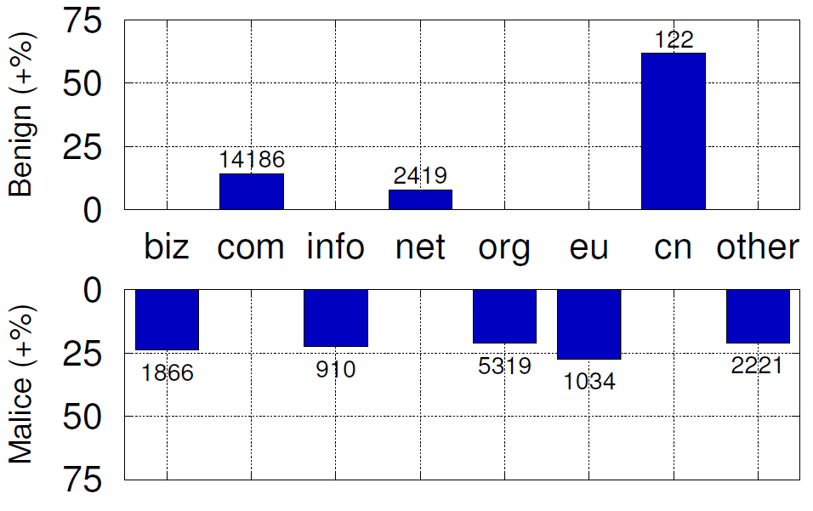
LEXICAL FEATURES: DOMAIN GRANULARITY
DOMAIN TLD
Why is ORG bad?
Cost-effective TLDs
Non-threats in COM/NET
DOMAIN LENGTH & DOMAIN ALPHA RATIO
Address memorability
Lack of DGAs?
(SUB)DOMAIN DEPTH
Having one subdomain (sub.domain.com) often indicates shared-use settings; indicative of threats
Fig: Class patterns by TLD after normalization; Data labels indicate raw quantities

Slide 13
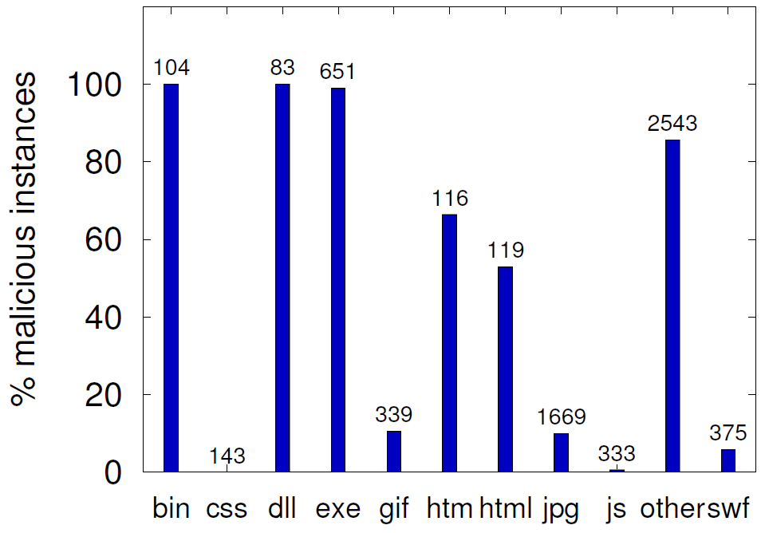
LEXICAL FEATURES: URL GRANULARITY
Some features require URL paths to calculate:
URL EXTENSION
Extensions not checked
Executable file types
Standard textual web content & images
63 “other” file types; some appear fictional
URL LENGTH & URL DEPTH
Similar to domain case; not very indicative
Fig: Behavioral distribution over file extensions (URLs only); Data labels indicate raw quantity
Notes:
* Fictionalized extensions often map to C&C instruction

Slide 14
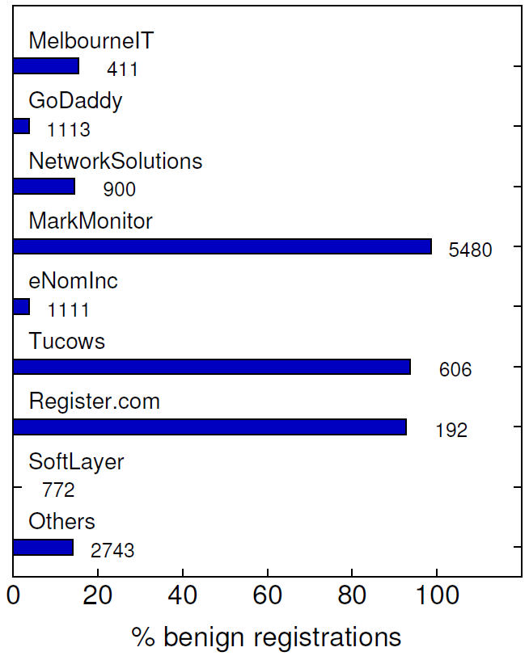
WHOIS DERIVED FEATURES
Fig: Behavioral distribution over popular registrars (COM/NET/CC/TV)
55% zone coverage; zones nearly static
DOMAIN REGISTRAR*
Related work on spammers [2]
MarkMonitor’s customer base and value-added services
Laggard’s often exhibit low cost, weak enforcement, or bulk registration support [2]
* DISCLAIMER: Recall that SLDs of a single customer may dramatically influence a registrar’s behavioral distribution. In no way should this be interpreted as an indicator of registrar quality, security, etc.

Slide 15
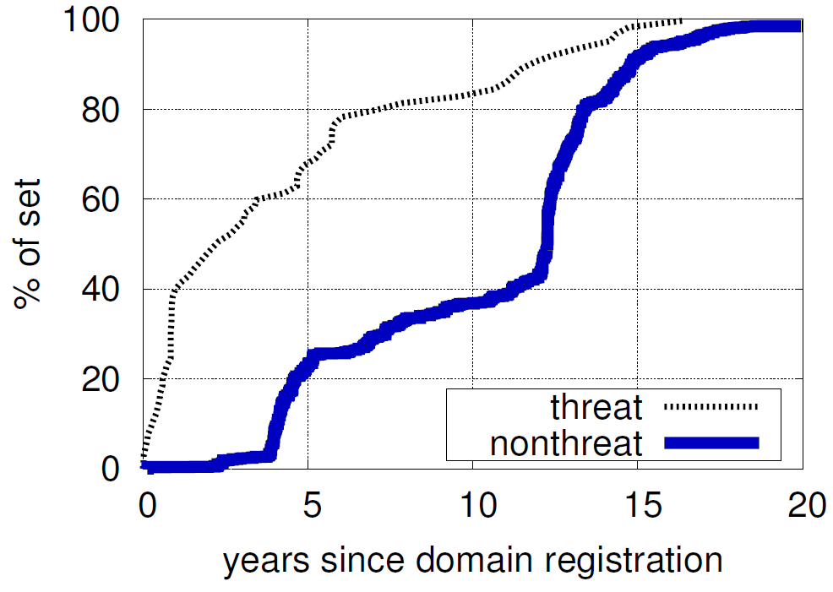
WHOIS DERIVED FEATURES
DOMAIN AGE
40% of threats <1 year old
@Median 2.5 years for threats vs. 12.5 non-threat
Recall shared-use settings
Economic factors, which in turn relates to…
DOMAIN REG PERIOD
Rarely more than 5 years for threat domains
DOMAIN AUTORENEW
Fig: CDF for domain age (reg. to malware label)

Slide 16
N-GRAM ANALYSIS
DOMAIN BAYESIAN DOCUMENT CLASS
Lower-order classifier built using n $∈$ [2,8] over unique SLDs
Little commonality between “non-threat” entities
Bayesian document classification does much …
… but for ease of presentation … dictionary tokens with 25+ occurrences that lean heavily towards the “threat” class:
mail | news | apis | free | easy
korea | date | yahoo | soft | micro
online | wins | update | port | winsoft
Tab: Dictionary tokens most indicative of threat domains

Slide 17
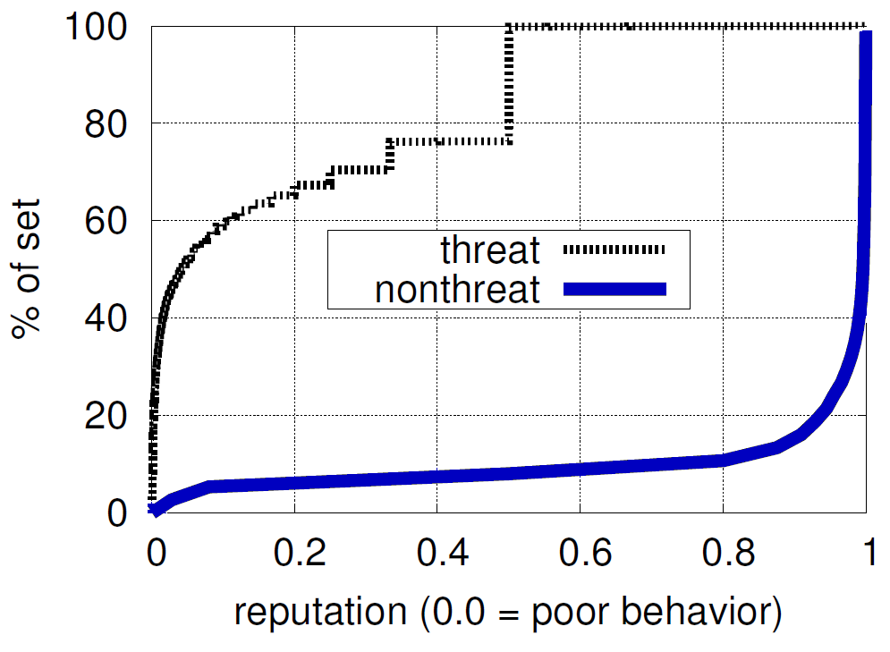
DOMAIN BEHAVIORAL REPUTATION
DOMAIN REPUTATION
Calculate “opinion” objects based on Beta probability distribution over a binary feedback model [3]
Reputation bounded on [0,1], initialized at 0.5
Novel non-threat SLDs are exceedingly rare
Area-between-curve indicates SLD behavior is quite consistent
CAVEAT: Dependent on accurate prior classifications
Fig: CDF for domain reputation. All reputations held at any point in time are plotted.

Slide 18
Classifying Endpoints with Network Metadata
1. Obtaining and labeling malware samples
2. Basic/qualified corpus properties
3. Feature derivation [lexical, WHOIS, n-gram, reputation]
4. Model-building and performance

Slide 19
FEATURE LIST & MODEL BUILDING
FEATURE | TYPE | IG
DOM_REPUTATION | real | 0.749
DOM_REGISTRAR | enum | 0.211
DOM_TLD | enum | 0.198
DOM_AGE | real | 0.193
DOM_LENGTH | int | 0.192
DOM_DEPTH | int | 0.186
URL_EXTENSION | enum | 0.184
DOM_TTL_RENEW | int | 0.178
DOM_ALPHA | real | 0.133
URL_LENGTH | int | 0.028
[snip 3 ineffective features] | .. | …
Random-forest model
Decision tree ensemble
Missing features
Human-readable output
WHOIS features (external data) are covered by others in problem space.
Results presented w/10×10 cross-fold validation
Tab: Feature list as sorted by information-gain metric

Slide 20
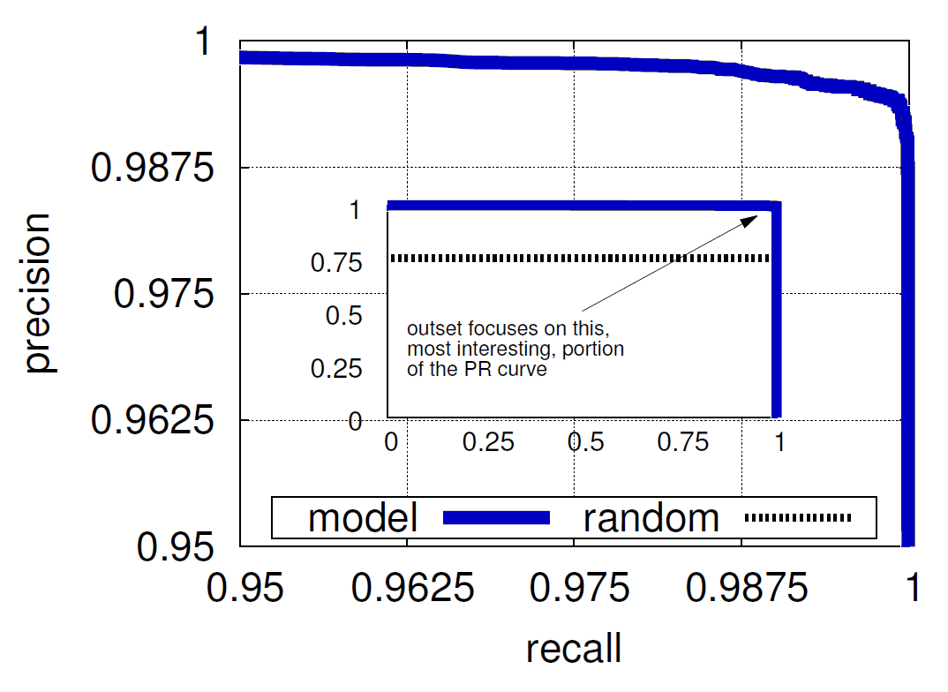
PERFORMANCE EVALUATION (BINARY)
BINARY TASK
99.47% accurate
148 errors in 28k cases
No mistakes until 80% recall
0.997 ROC-AUC
Fig: (inset) Entire precision-recall curve; (outset) focusing on the interesting portion of that PR curve

Slide 21
PERFORMANCE EVALUATION (SEVERITY)
Classed→ Labeled ↓ | Non | Low | Med | High
Non | 7036 | 308 | 17 | 104
Low | 106 | 12396 | 75 | 507
Med | 8 | 89 | 1256 | 53
High | 36 | 477 | 64 | 5485
Severity task under- emphasized for ease of presentation
Tab: Confusion matrix for severity task
• 93.2% accurate • Role of DOM_REGISTRAR
• 0.987 ROC-AUC • Prioritization is viable

Slide 22
DISCUSSION
Remarkable in its simplicity; metadata works! [4]
Being applied in production
Scoring potential indicators discovered during sandboxing
Preliminary results comparable to offline ones
Gamesmanship
Account/Sybil creation inside services with good reputation
Use collaborative functionality to embed payloads on benign content (wikis, comments on news articles); what to do?
Future work
DNS traffic statistics to risk-assess false positives
More DDNS emphasis: Monitor “A” records and TTL values
Malware family identification (also expert labeled)

Slide 23
CONCLUSIONS
“Threat indicators” and associated blacklists…
… an established and proven approach (VRSN and others)
… require non-trivial analyst labor to avoid false positives
Leveraged 28k expert labeled domains/URLs contacted by malware during sandboxed execution
Observed DDNS and shared-use services are common (cheap and agile for attackers), consequently an analyst labor sink
Utilized cheap static metadata features over network endpoints
Outcomes and applications
Exceedingly accurate (99%) at detecting threats; reasonable at predicting severity (93%)
Prioritize, aid, and/or reduce analyst labor

Slide 24
REFERENCES & ADDITIONAL READING
[01] Mohaisen et al. “A Methodical Evaluation of Antivirus Scans and Labels”, WISA ‘13.
[02] Hao et al. “Understanding the Domain Registration Behavior of Spammers”, IMC ‘13.
[03] Josang et al. “The Beta Reputation System”, Bled eCommerce ‘02.
[04] Hao et al. "Detecting Spammers with SNARE: Spatio-temporal Network-level Automatic Reputation Engine", USENIX Security ‘09.
[05] Felegyhazi et al. “On the Potential of Proactive Domain Blacklisting”, LEET ‘10.
[06] McGrath et al. “Behind Phishing: An Examination of Phisher Modi Operandi”, LEET ‘08.
[07] Ntoulas et al. “Detecting Spam Webpages Through Content Analysis”, WWW ‘06.
[08] Chang et al. “Analyzing and Defending Against Web-based Malware”, ACM Computing Surveys ‘13.
[09] Provos et al. “All Your iFRAMEs Point to Us”, USENIX Security ‘09.
[10] Antonakakis et al. “Building a Dynamic Reputation System for DNS”, USENIX Security ‘10.
[11] Bilge et al. “EXPOSURE: Finding Malicious Domains Using Passive DNS …”, NDSS ‘11.
[12] Gu et al. “BotSniffer: Detecting Botnet Command and Control Channels … ”, NDSS ‘08.

Slide 26
RELATED WORK
Endpoint analysis in security contexts
Shallow URL properties leveraged in spam [5], phishing [6]
Our results find the URL sets and feature polarity to be unique
Mining content at endpoints; looking for commercial intent [7]
Do re-use domain registration behavior of spammers [2]
Sandboxed execution is an established approach [8]
Machine assisted tagging alarmingly inconsistent [1]
Network signatures of malware
Google Safe Browsing [9]; drive-by-downloads, no passive endpoints
Lots of work at DNS server level; a specialized perspective [10,11]
Network flows as basis for C&C traffic [12]

